Slide 1

A 4R2W Register File for a 2.3GHz Wire-Speed POWER™ Processor with Double-Pumped Write Operation
G. S. Ditlow¹, R. K. Montoye¹, S. N. Storino², S. M. Dance²,
S. Ehrenreich³, B. M. Fleischer¹, T. W. Fox¹, K. M. Holmes⁴, J. Mihara⁵, Y. Nakamura⁵, S. Onishi⁵, R. Shearer², D. Wendel⁶, L. Chang¹
¹IBM T. J. Watson Research Center, Yorktown Heights, NY
²IBM Systems and Technology Group, Rochester, MN
³Now with Hoerner & Sulger GmbH, Schwetzingen, Germany
⁴IBM Systems and Technology Group, Essex Junction, VT
⁵IBM Systems and Technology Group, Kyoto, Japan
⁶IBM Systems and Technology Group, Boeblingen, Germany
2011 ISSCC

Slide 2
Outline
Motivation: Double-Pumping + Replication
Implementation
Experimental Results
Summary
2011 ISSCC

Slide 3
Register Files in μP Applications
Register
File
Generate
ECC
Write Data
Functional
Unit
Read Data
Check
ECC
Latency
= Array Access
+ ECC
+ Communication
Register Files: Highest-speed memory in a microprocessor
  As used, latency includes array, error correction, and I/O
Goal of this work:
  Single-cycle latency: Fast array access + error correction
  High density and low power
2011 ISSCC
Notes:
Our goal is to reduce latency to improve system design. This latency includes producing the checking data, verifying the data and distributing the data to the appropriate locations

Slide 4
Double-Pumped Ports
2N-port
RF Cell
(4N² cross points)
2N
Word Lines
N
Word Lines
N-port RF Cell
(N² cross
points)
N Bit Lines
2N Bit Lines
RF cell size varies quadratically with number of read/write ports
Double-pumping: Operate ports twice in a single clock cycle
  # ports can be halved = ~4x reduction in cell size
  High-speed techniques needed to maintain cycle time
Fewer ports = Small cell = Short BL = High speed/Low power
2011 ISSCC
Notes:
Cells above 3 to 4 ports tend to be wire limited.

Slide 5
Read Data Replication
4R1W
RF Cell
(25 cross points)
5
Word
Lines
3
Word
Lines
2R1W
(9 cross points)
3
Word
Lines
2R1W
(9 cross points)
4 Bit Lines
4 Bit Lines
6 Bit Lines
Two copies of small cell with ½ read ports: Mimics large cell
  Write same data into duplicated arrays
  Total area may be smaller: Cell size is quadratic w/# ports
Fewer read ports = Small cell = Short BL = High speed/Low power
2011 ISSCC
Notes:
Embodying a register file with 4 read ad 2 write ports can be split with area gain into 2 smaller cells, with additional benefits

Slide 6
Parity-Based Error Correction
Data Copy 0
Parity 0
Data Copy 1
Parity 1
Read Ports 0/1
Parity Check
Read Ports 2/3
Parity Check
If error, correct
data is in copy 1
If error, correct
data is in copy 0
Parity code generation/checking is faster than traditional ECC
  3 XOR delays vs. 6 XOR delays
With data replication, parity enables superior error correction
  If only 1 copy has any error correct value can be recovered
  No single error can affect both copies
  Many multi-bit errors can also be corrected
2011 ISSCC

Slide 7
Outline
Motivation: Double-Pumping + Replication
Implementation
Experimental Results
Summary
2011 ISSCC

Slide 8
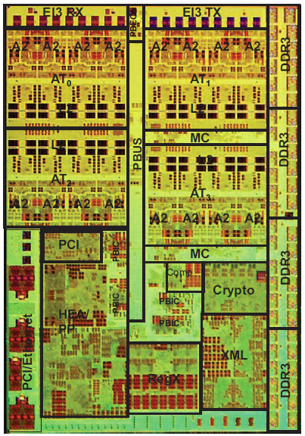
A Wire-Speed POWER™ Processor
4R2W register file
  144 × 78b (66b data + 12b parity)
  3 address operations + load/store
  32 copies
This work:
  Demonstrate low latency access and area/power efficiency by reducing cell-level port count
  Achieve single-cycle access latency at 2.3GHz to function units
C. Johnson, et al.,
ISSCC ‘10
2011 ISSCC
Notes:
We will now examine the implementation of a 4R2W register file for the Wire Speed POWER processor

Slide 9
4R2W Cell → Two 2R1W Cells
2R1W
2
4R2W
RWL
4
WWL
RWL
2
2x1
(T/C)
2
WWL
RBL
WBL
2R1W
2x2
(T/C)
2
4
RWL
RBL
WBL
WWL
2
2x1
(T/C)
RBL
WBL
Reduce cell-level ports: Two 2R1W cells perform 4R2W function
  Double-pumped write port: Single-pumped read for low latency
  Replicated read ports: Small cell enables short WL/BL length
3-4x cell size reduction = 1.5-2x total cell area reduction
2011 ISSCC
Notes:
This implementation includes double pumping the write ports and duplication of the read ports.

Slide 10
Small Cell Size: Macro-Level Impact
2x2R1W: Comparison vs. 4R2W
 | Ideal Improvement Factor | Reason
Area | ~0.5x | 2 copies of smaller cell
Leakage Power | ~0.5x | Scales with area
Read Access Time | ~0.5x | Shorter WL/BL
Read Power | ~0.5x | Shorter BL
Write Latency | ~0.5x | Shorter WL/BL
Write Power | ~1x | 2 copies + shorter BL
Counter to intuition, double-pumping + cell replication reduce power and area while improving latency
  Small cell reduces WL/BL lengths by ½
  Fast write enables double pumping
  Fast read creates sufficient slack to reach functional unit
2011 ISSCC
Notes:
We present the counter-intuitive reselut of gain through running faster and data duplication.

Slide 11
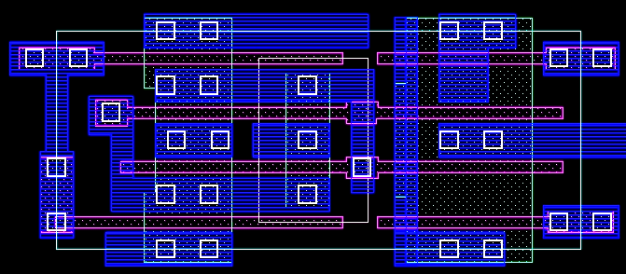
2R1W Cell Layout Optimization
WBL
RBL0
RWL0
WWL
Cell size
1.824μm × 0.76μm
= 1.39μm²
RWL1
WBLb
RBL1
Three ports (2R1W) is optimal for cell layout density
  Terminals at cell edge: Contacts shared w/neighboring cells
  Neither strongly wire-limited or device-limited
WL and BL width/spacing optimized to maximize performance
2011 ISSCC

Slide 12
Array Floorplan
2R1W
Cells
2R1W
Cells
Organization: 144 entries × 78b
  4R2W = Two copies of 2R2W arrays
  Two smaller arrays facilitate chip-level floorplanning
Read/write circuits located in center of array
  Halve WL/BL lengths for speed
  Macro-level I/O traverses additional ½ macro height
40% array efficiency
80 entries
Word Line Driver
I/O Drivers,
Latches
Pre-Decode +
Clock Buffers
I/O Drivers,
Latches
2R1W
Cells
2R1W
Cells
64 entries
Word Line Driver
39b
39b
2R2W Area: 0.044mm²
(191μm × 231μm)
4R2W Area: 0.088mm²
2011 ISSCC

Slide 13
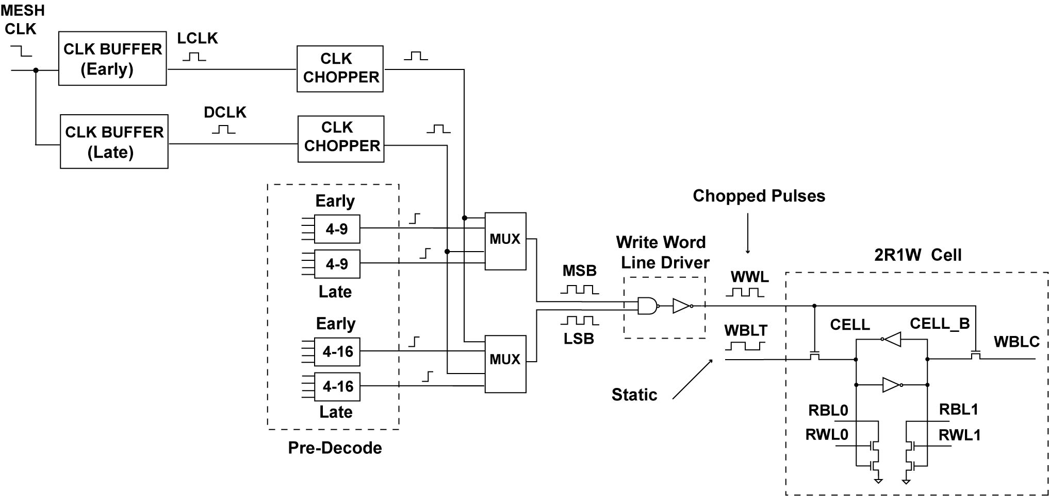
Double-Pumped Write: Decode Path
Write pulses on front and back clock edges
Key consideration: Low latency and robust pulses
Combine MSB/LSB near final driver
Wide WWL wire for 2x frequency
Static mux merges early/late addresses
Early/late share predecode drivers/wires
2011 ISSCC
Notes:
We will first focus on the write data path since it is double pumped. We have duplicate predecode stages and merge their results using the front and back cock edges to the pre-decode wiring path.

Slide 14
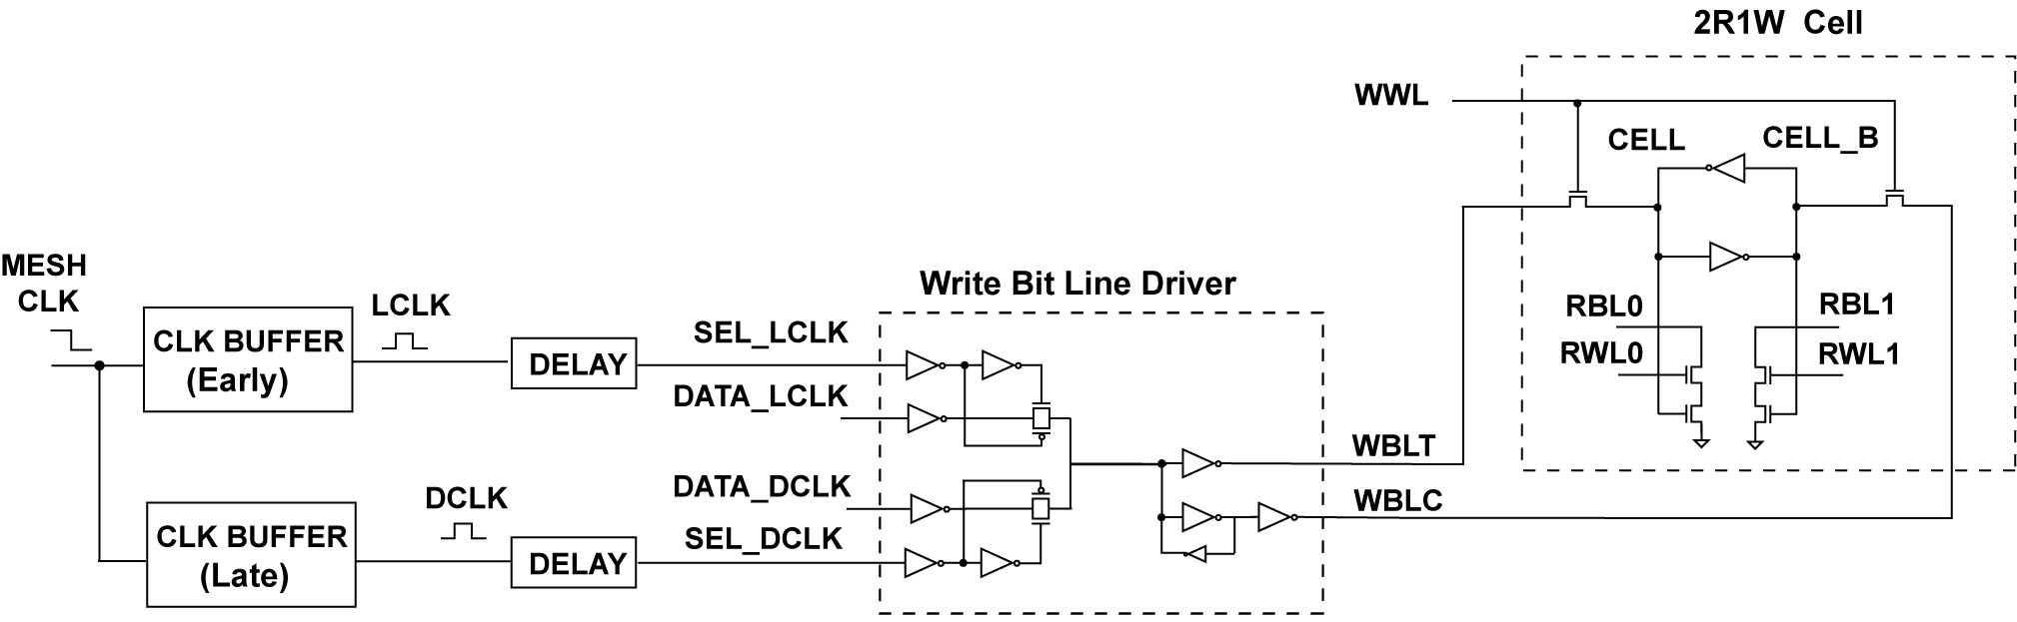
Double-Pumped Write: Data Path
T-gate mux merges early/late data w/minimal WBL glitching
Feedback inverter latches WBL state
Key consideration: Alignment of decode and data path timing
2011 ISSCC

Slide 15
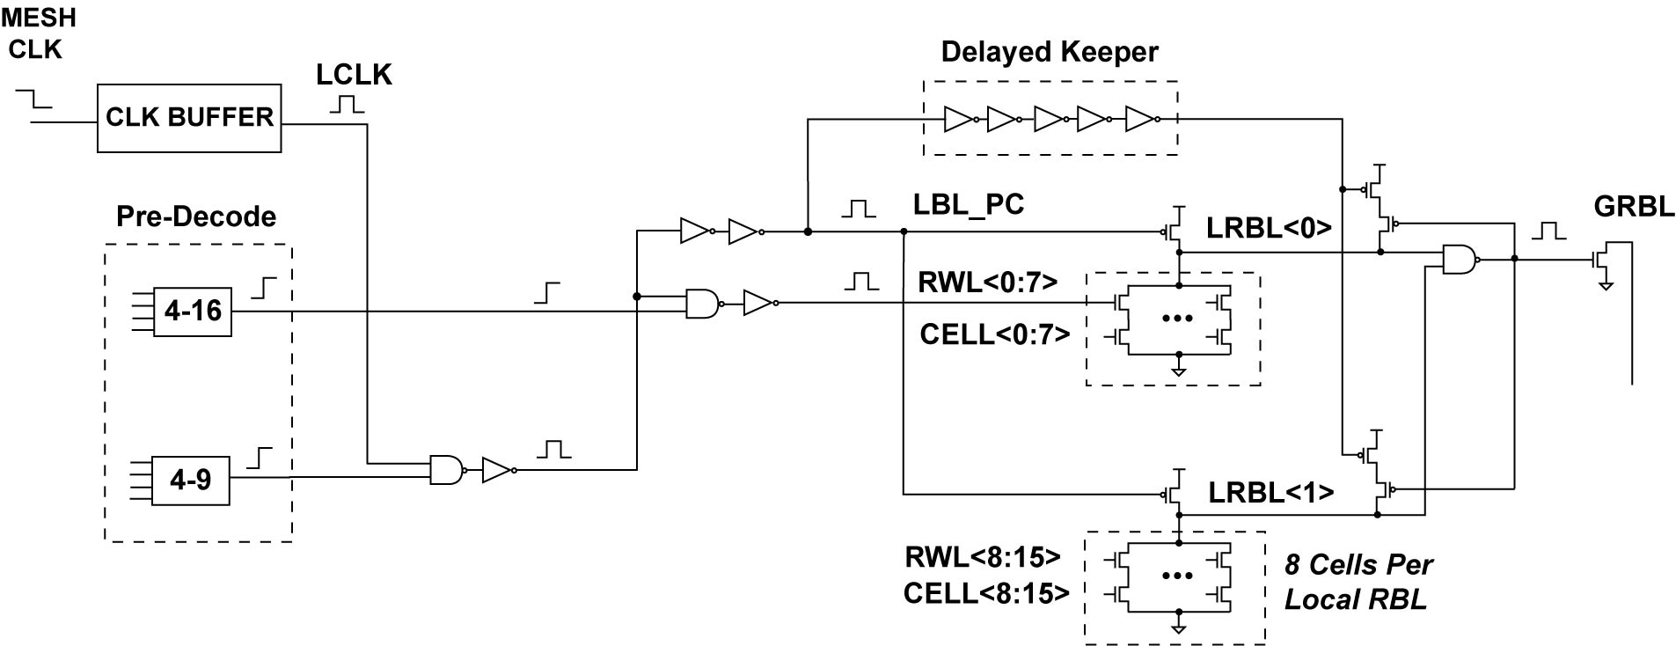
Read Path: Decode + Local Eval
Static LSB signals for robustness
Delayed keeper
MSB pulses set RWL timing
Static NAND2 merges local RBL
8 cells per local RBL
Key consideration: Low latency
2011 ISSCC

Slide 16
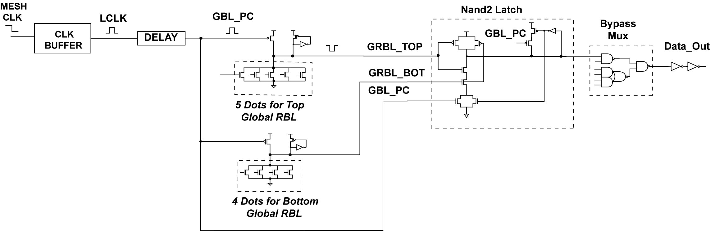
Read Path: Global Eval
Standard keeper
4 or 5 dots per global RBL
Fast dynamic latch w/built-in NAND2 combines top/bottom global RBL
Limited Switch Dynamic Logic
W. Belluomini, et al., ISSCC ‘05
Key consideration: Low latency
2011 ISSCC

Slide 17
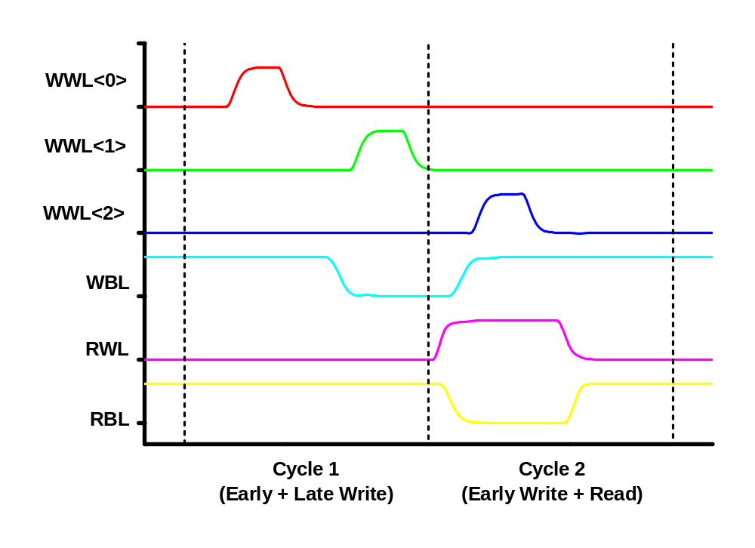
Critical Timing Margins
Pulse width/separation
Early
Write
Late
Write
WBL setup/hold
Early
Write
Late write completion
Read
Balance robustness of write and read operations with latency
2011 ISSCC
Notes:
Double pumping the write produces some additional timing margin issues

Slide 18
Critical Margin Analysis
PVT variation
Merging pulses reduces
worst-case pulse widths
RC Delays
Wire delays across
physical array corners
Mid-Cycle Jitter
Clock back edge sets
late pulse and is not
well-controlled
WL0
RF
Cell
RF
Cell
Clock
Pulse too
narrow
Offset
Pulses
WL79
RF
Cell
RF
Cell
Pulses
BL0
BL38
90/127ps nominal WWL pulse width/separation confirms operating margins
2011 ISSCC
Notes:
There are a myriad of varibiility issues that must be anlysed in rder to guarantee the unit under variability, including proces/vltage timing issues spatial rc delay issues and the mid cycle jitter of the clock

Slide 19
Error Correction: Interleaved Parity
Data Bits
Parity Bits
Single Bit
Detected
Error
Detected
Contiguous Bits
Detected
Multi-bit
Detected
Even # errors in same parity set
Not detected
Interleaved parity detects all single-bit and many multi-bit errors
  Upon detection, correct data can be copied from other array (if clean)
Byte parity computation enables low latency (3 XORs)
2011 ISSCC
Notes:
The implewmentation included interleaving on the parity bits wide enough to avid a single event produceing comppleementaty erros in the sam perity grup
The multipe groups are shown as pink,yellw and blue with errors shown qith X’s
As you can see multiple errors are detected as long as they to not produce cancelling parity effects for all check sets

Slide 20
Dual Copy Parity Error Correction
1 Double-Pumped Write Port
Armed
Instruction Unit
2R1W
Array
2R1W
Array
State machine for data recovery
Use logic for existing “Select” instruction
  Read faulty register from both arrays
  Rewrite both arrays w/correct data
Parity Error
Triggered
4 Read
Ports
Pipeline
stalled
Parity Check
Insert
Select op
Select
Corrected
Pipeline
started
2011 ISSCC
Notes:
Walk theough the state machine expicitly

Slide 21
Outline
Motivation: Double-Pumping + Replication
Implementation
Experimental Results
Summary
2011 ISSCC

Slide 22
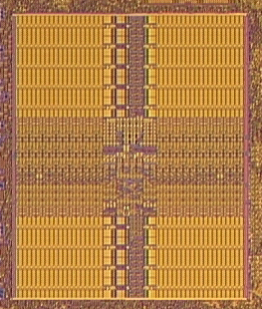
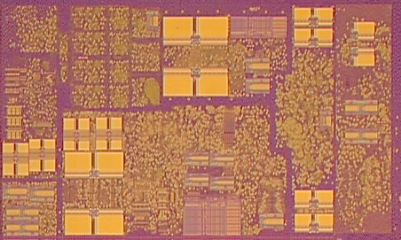
45nm SOI-CMOS Implementation
Array
WL Drv
Array
I/O
Decode
I/O
Array
WL Drv
Array
A2 microprocessor core (C. Johnson, et al., ISSCC ‘10)
2 copies of 4R2W array = 4 copies of base 2R2W array
2011 ISSCC
Notes:
We implemented this design in 45nm CMOS and included this in the Wire speed processor. The 4 copies per cre are illiustrated in this microphorgraph alng with a blow-up of the register file

Slide 23
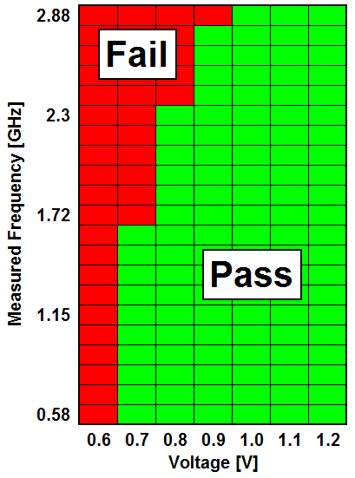
Measured Results
2.76 Ghz at nominal supply of 0.9V
  Scales with the rest of the processor
1.6 GHz maintained down to 0.7V supply
  Dual-rail write allows excellent voltage scaling
2011 ISSCC
Notes:
As you can see the part is working af 2.76 Ghz @ .9v, scaling to 1.6Ghz @ 0.7v

Slide 24
Summary
Demonstrated a 4R2W register file in 45nm SOI-CMOS with low latency and area/power efficiency
  Using synergistic mutually inclusive techniques
Key focus: Reduction of cell-level port count
  Double-pumping for write port reduction
  Replication for read port reduction
Data duplication enables error correction using a fast parity code
2011 ISSCC

Slide 25
Acknowledgements
Characterization assistance: R. Redmond, R. Robertazzi
Charlie Johnson, Jeff Brown, and the PowerEN Research & Development Teams
Management support: W. Haensch, G. Shahidi, L. Heng
2011 ISSCC

